Slide 1

Overconfidence
Notes on Behavioural Economics
Jason Collins

Slide 2
“Perhaps the most robust finding in the psychology of judgment and choice is that people are overconfident.”

Slide 3


Slide 4
90%

Slide 5
90%

Slide 6
90%
Length: 6,650km

Slide 7
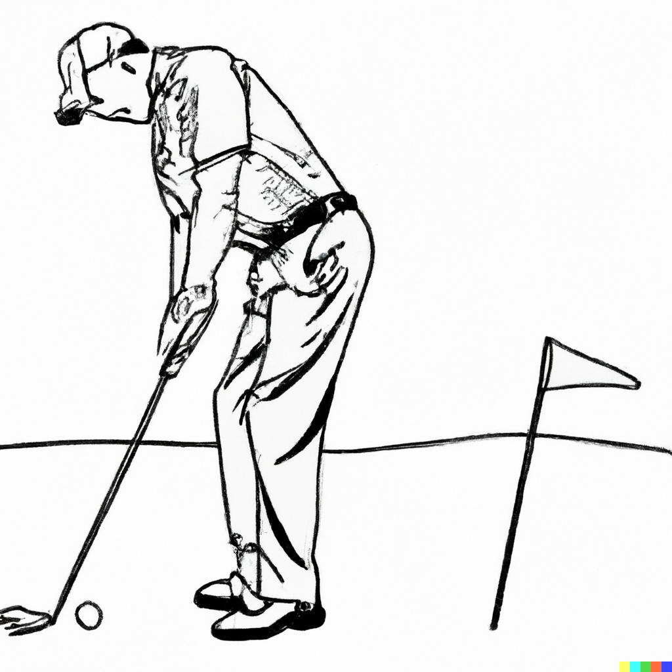

Slide 8
93%

Slide 9
25%

Slide 10
Overprecision
The tendency to believe that our predictions or estimates are more accurate than they actually are

Slide 11
Overestimation
The belief that we can perform at a level beyond that which we realistically can.

Slide 12
Overplacement
The erroneous relative judgement that we are better than others

Slide 13
Easy tasks Hard tasks
Overplace Underplace
Underestimate Overestimate

Slide 14


Slide 15
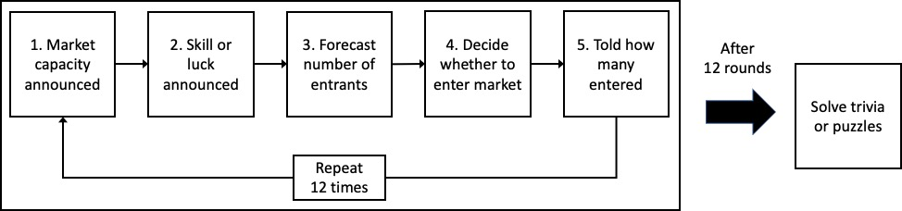

Slide 16
